Slide 1



Introduction to the UN Sustainable Development Goals (SDGs):
SDG7: Affordable and Clean Energy for All
The United Nations Sustainable Development Goals (SDGs) outline a shared blueprint for a better future for all. SDG7 focuses on ensuring access to affordable, reliable, sustainable and modern energy for all.
by Katana Ngumbao

Slide 2
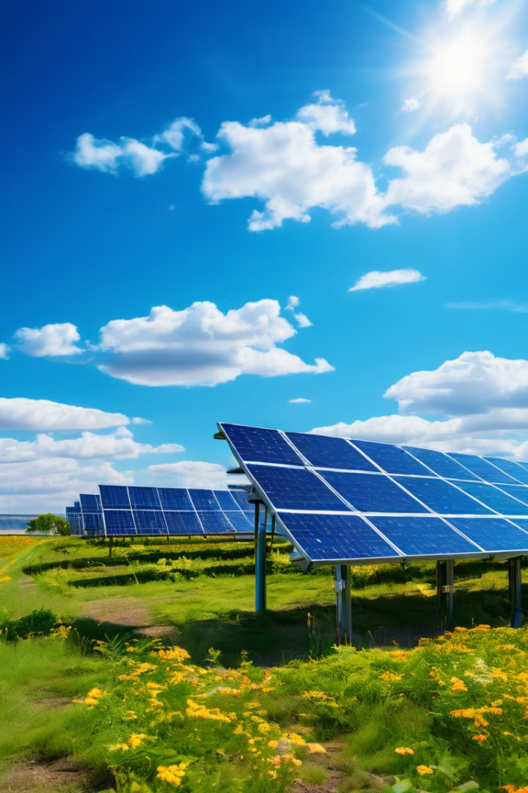
To Ensure Clean Energy to All
1
Energy Poverty
2
Sustainable Energy
Over 1 billion people lack access to electricity, hindering economic growth and human development.
Transitioning to cleaner energy sources is vital to mitigate climate change and protect our environment.
3
Universal Access
4
Global Cooperation
SDG7 aims to ensure access to affordable, reliable, sustainable and modern energy for all by 2030.
Collaboration is crucial between governments, businesses, and communities to achieve this goal.

Slide 3
Current Global Energy Landscape
The world's energy system relies heavily on fossil fuels, contributing significantly to climate change and air pollution. These fuels are finite resources, and their extraction and use can have detrimental impacts on communities and ecosystems. Developing countries often struggle with energy poverty, lacking access to reliable and affordable energy, hindering economic growth and social development.

Slide 4
Project Objectives
The primary objective of SDG7 is to ensure access to affordable, reliable, sustainable, and modern energy for all. Our data-driven approach aims to utilize data insights to improve decision-making and optimize business operations. By leveraging data analytics, we can identify key trends, patterns, and opportunities for growth in the energy sector.

Slide 5
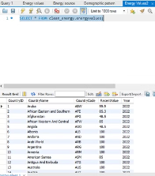
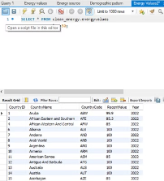
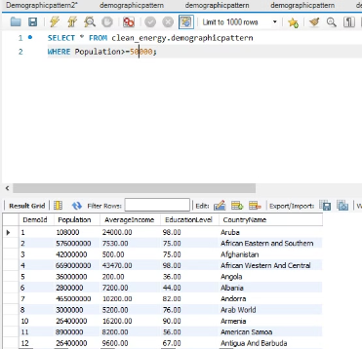
Snippets of the Database schema

Slide 6
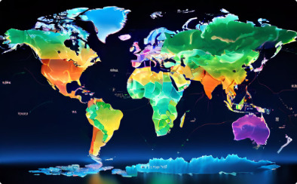

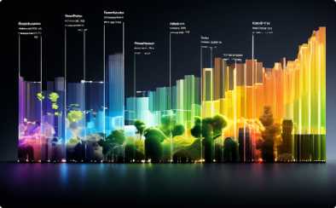
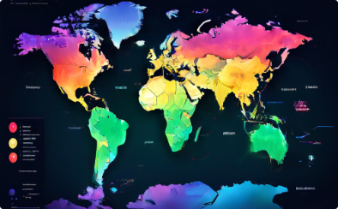
Current Global Energy Landscape
Energy Consumption Trends
Renewable Energy Deployment
Global Energy Mix
Energy Poverty
The data sheds light on the current reliance on fossil fuels and the potential for transitioning to cleaner energy sources.
Analyzing data on energy poverty reveals the extent of the challenge and guides efforts to provide universal access to electricity.
Data insights reveal the global patterns of energy consumption, highlighting regions with high and low energy usage.
The analysis of renewable energy resources provides insights into the potential for sustainable energy development across the globe.

Slide 7
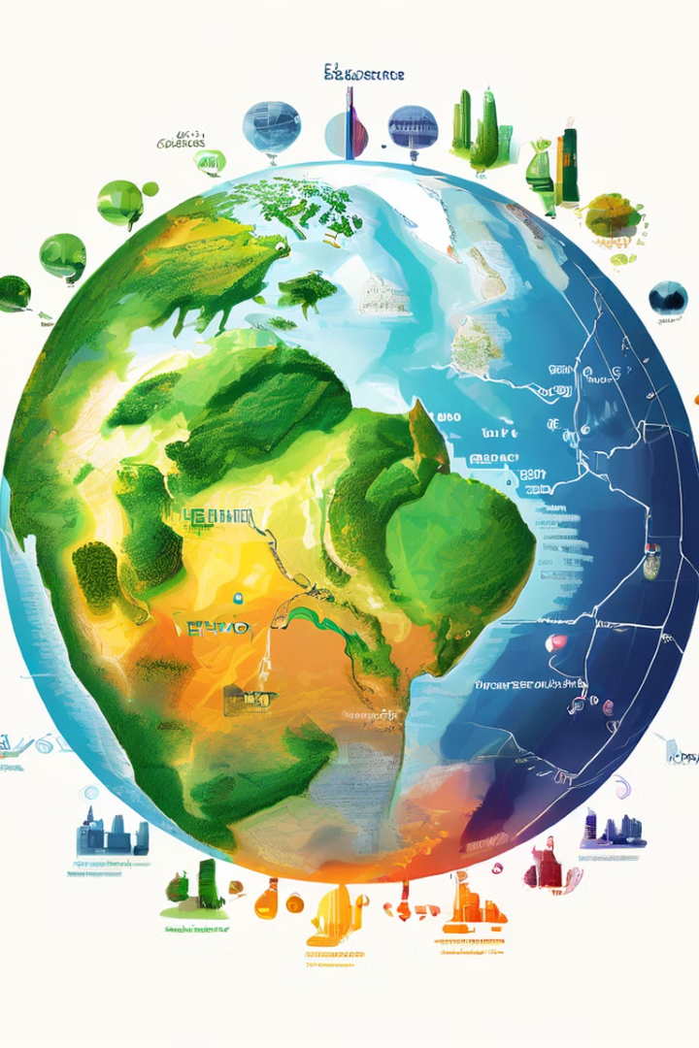
Current Global Energy Landscape
Fossil Fuels
Dominate the global energy mix but contribute significantly to pollution.
Renewable Energy
Growing rapidly, but still faces challenges in deployment and affordability.
Nuclear Energy
Low-carbon but controversial due to safety concerns and waste disposal.

Slide 8
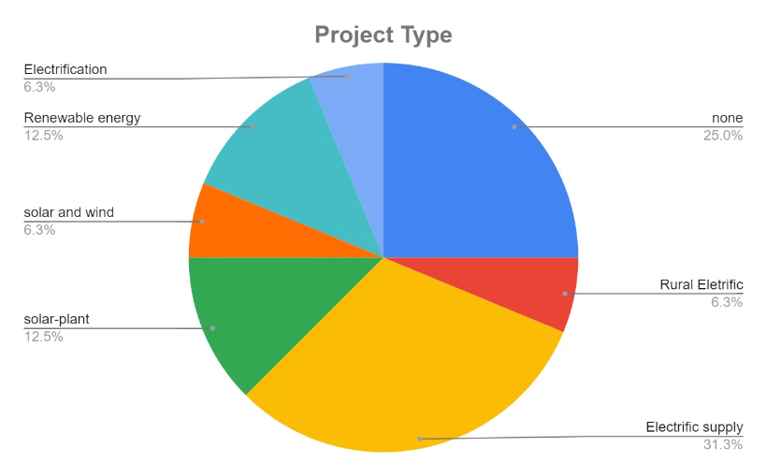
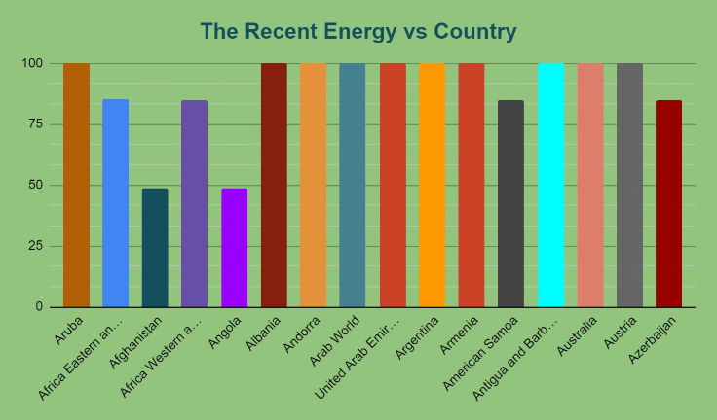
Recent Energy Distribution Across the Countries. Difference Energy projects that has been Established.

Slide 9

Strategies and Initiatives to Promote Affordable and Clean Energy
Decentralized Renewable Energy
1
Developing off-grid solutions using solar, wind, and biomass for rural areas.
2
Energy Efficiency Measures
Promoting energy-saving technologies and practices to reduce energy consumption.
Public-Private Partnerships
3
Encouraging collaborations between governments and private businesses to invest in clean energy.
4
Capacity Building and Knowledge Sharing
Training and education initiatives to develop a skilled workforce in the clean energy sector.

Slide 10

Conclusion and Call to Action
Achieving SDG7 requires sustained efforts from all stakeholders. By working together, we can create a future powered by clean and affordable energy for everyone.

